Slide 1
Hepatic Blood Flow (start at GI)
Liver
Hepatic Lobule
(functional unit of Liver)
Inferior
Portal Vein
Central Vein → Vena Cava
GI
Sinusoidal Space Filters
Heart
Aorta
Hepatic Artery
supplies oxygenated blood to sinusoids
Arteries to GI
Functions of Liver
Metabolism | Fats, Carbs, Protein, Drugs
Synthesis | Albumin, Clotting Factors, Glucose, Cholesterol
Conjugate | Bilirubin (breakdown of heme, yellow part of bruise)
Notes:
Problem is when blood is backed up

Slide 2
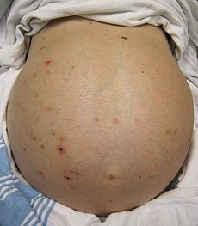
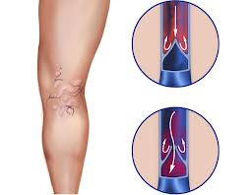
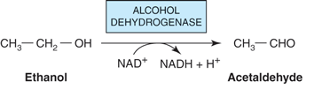
Definitions:
Steatosis: Fatty deposits
Cirrhosis: Fibrotic changes
Portal HTN: Portal – Central > 5 mmHg
8 – 10 mmHg = Varices = vein like (picture)
> 12 mmHg = Active bleeding
End-stage liver disease (ESLD): Progression to death unless liver transplanted
Ascites (fat)
Varices (vein)
Alcoholic liver disease (ALD): Spectrum from simple steatosis to cirrhosis
Inhibits oxidation of fatty acids → Increase Triglycerides → Steatosis → Cirrhosis
Telangiectasia: spider veins

Slide 3
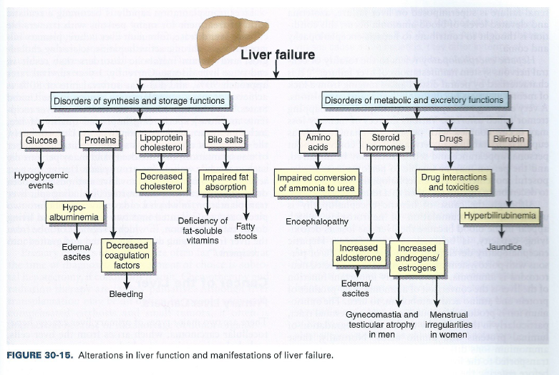

Slide 4
Cirrhosis: Fibrosis of hepatic parenchyma cells
Liver → Steatosis Liver → Hepatitis → Compensated Cirrhosis → Decompensated Cirrhosis
Normal Fat Inflamed Scarred but normal body
Jaundice, Ascites, Portal HTN
Cause of Cirrhosis | Examples
Drugs (cause acute liver failure) | Acetaminophen → affects glutathione Isoniazid Methyldopa Amiodarone methotrexate
Chronic Alcohol Consumption | 80 grams of ethanol (12 oz beer)
Hepatitis | Hep B, C, D
Metabolic Liver Disease | Cystic fibrosis
Immunologic Disease | Autoimmune hepatitis Biliary cirrhosis
Vascular disease | Cardiac failure
Notes:
Glutathione: used to prevent free radicals

Slide 5
Labs
Hepatic Panel Labs | Normal Values | Injury Values
AST | < 50 | > 3x ULN
ALT | < 50 | > 3x ULN
AST/ALT acute measurement | < 1 | > 2:1 ratio
Total Bilirubin chronic Direct Bilirubin | 0.1 – 1 mg/dL 0 – 0.4 mg/dL | Increase build up = jaundice Increase
Gamma-glutamyl Transpeptidase (GGT) | Men 0 – 85 U/L Women 0 – 40 U/L | Increase
Alkaline Phosphatase (ALP) | 30 - 120 | increase
Coagulation Labs | Normal Values | Injury Values
PT/INR | 1 | Increase = bleed
Platelets | 130,000 – 400,000 | Decrease = thrombocytopenia
Chem-12 Labs | Normal Values | Injury Values
Albumin (keep osmotic pressure) | 4 – 6 g/dL | Decrease b/c can’t produce Cause ascites
Notes:
Unconjugated bilirubin = free bilirubin = indirect bilirubin
24 epidemilology
25 patho-28
29 compensated vs decompensated
30 - 31 clinical presentation
32 labs 32 36

Slide 6
Tx of Cirrhosis
Varices (vein) → BB
Ascites (fat gut) → Spironolactone + Furosemide
Spontaneous Bacterial Peritonitis (SBP) → Ceftri
Encephalopathy (ammonia) → Lactulose

Slide 7
Cirrhosis/End Stage Liver Disease
Poor Liver Function
Portal HTN
Portal Pressure > 5 mm/Hg
Coagulation
Disorders
Hepatic
Encephalopathy
(brain)
Altered
Metabolism
Ascites
(fat stomach)
Varices
(Vein)
Vitamin K
Platelets
FFP
Lactulose Syrup
15 – 45 mL PO q8h
Gastroesophageal Varices
Spironolactone
+
Furosemide
Spontaneous Bacterial
Peritonitis (SBP)
Infection of gut cavity
Prevention Tx
Pressure 8-10
Acute Tx
Pressure > 12
Propranolol 20 mg PO BID
or
Nadolol 40 mg PO daily
EBL
or
Octreotide
+
Fluid
+
Coagulopathy
+
Prevent Infection
+
Prevent rebleeding
Empiric:
Ceftriaxone 2g q24h
or
Cipro 500 mg q12h
Prophylaxis Norfloxacin 400 mg PO
TMP sulfa DA 800 mg/160 mg daily
Notes:
Varices: dilated vessels that may break
Stop or slow blood loss: Endoscopic Band or Octreotide
Fluid Resuscitation
Correct Coagulopathy
Prevent infection
Prevent rebleeding

Slide 8
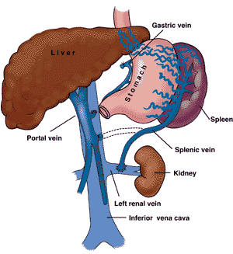
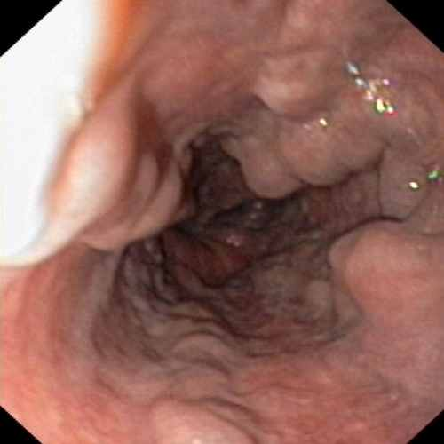
Portal HTN: Gastroesophageal Varices
Gastroesophageal Varices Pathogenesis (picture)
Some blood from esophagus drains into gastric vein which drains directly into portal vein. Increase pressure of portal vein will increase pressure of gastric vein causing varices → Bleeding
Drug to PREVENT Gastroesophageal Varices | Titrate | Monitor
Propranolol 20 mg PO BID | Titrate q2-3 days | CNS HR > 55 bpm BP
Nadolol 40 mg PO daily | “ “ | Less CNS than propranolol
ACUTE Bleed Tx Gastroesophageal Varices | MOA
Endoscopic Band Ligation (EBL) | Wrap rubber band around bleeding vessel → vein necrosis → heal in 3 weeks
Octreotide 50 mcg IV bolus 50 mcg/hr x3-5 days | Analog of Somatostatin. Reduce protal pressure through vasoconstriction of splanchnic vasculature
Other | Fluid, Coagulopathy, prevent infection and rebleeding
Esophageal varices
Prevent 2nd Bleed Gastroesophageal Varices | Monitor
Nonselective BB + EBL | Portal Pressure < 12 mmHg
Notes:
Know BB dosing
esophagus is drained into the superficial veins lining the esophageal mucosa, which drain into the left gastric vein (coronary vein), which in turn drains directly into the portal vein.

Slide 9
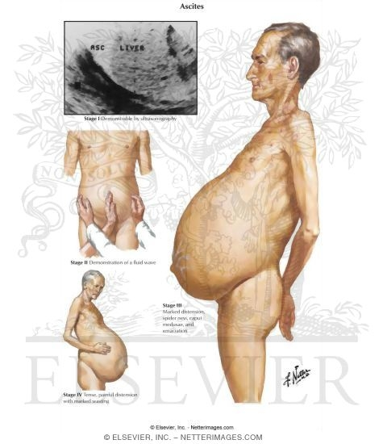
Ascites: Pathophysiology
Cirrhosis/Portal HTN
Increase Nitric Oxide
Vasodilation
Decrease Arterial Blood Volume
Activation of Renin-Angiotensin-Aldosterone System
Hyperdynamic Circulation
Monitor: BP
Na and Water Retention
Monitor: Na, K, Mg
Renal Vasoconstriction
Monitor: SCr, BUN, CrCl
Ascites: accumulation of fluid in peritoneal cavity
Most common complication
Affects 50% of cirrhotic pts within 10 years of diagnosis

Slide 10
Ascites
Assessment: Serum-Ascites Albumin Gradiant (SAAG)
SAAG = Serum Albumin – Ascites Albumin
If SAAG > 1.1 g/dL then portal HTN
Tx: Use Aldosterone + Diuretic 100 mg: 40 mg Ratio
Aldosterone | Dose
Moderate Ascites | Spironolactone 50 – 200 mg daily | + | Furosemide 20 – 80 mg daily
Large Ascites | Spironolactone 200 – 400 mg daily | + | Furosemide 160 mg daily
Baseline Measurements:
Renal:
SCr, BUN, CrCl, K, Mg, Na, BP
Notes:
Serum albumin: 3.2 - 5 g/dl

Slide 11
Spontaneous Bacterial Peritonitis (SBP)
SBP |  | notes
Diagnosis | Neutrophils > 250/mm³ + Cultures | Tx of suspected
Bacteria | E. Coli Klebsiella pneumonia Pneumococci | Traveled from GI
Empiric Tx | 3rd gen cephalosporins Ceftriaxone 1 – 2 g q24h Cefotaxime 2 g q8h If PCN allergy then FQ Ciprofloxacin 500 mg q12h Norfloxacin 400 mg q12h | Duration: If + cultures then Tx for 10 days If - cultures then Tx for 5 days
Add Albumin (consider) | If want to remove > 5 L Albumin Day 1 1.5 g/kg 1 dose Albumin Day 3 1 g/kg 1 dose | IV infusion improves mortality in SBP
Long Term Prophylaxis b/c 70% recurrence | Norfloxacin 400 mg daily or TMP Sulfa DS 160mg/800 mg daily | Norfloxacin is preferred
Monitor | WBC, Fever Abdominal pain, GI bleed Renal dysfunction S/S encephalopathy
Notes:
Add albumin when:
> 5 L
Bilirubin > 4
SCr > 1
BUN > 30

Slide 12
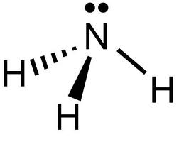
Hepatic Encephalopathy (HE)
Normal Liver: Bacteria in GI make Ammonia → Liver converts ammonia to urea → excreted
Cirrhosis Liver: Bacteria in GI makes ammonia → liver can’t convert → enters cerebral circulation → Enceph
HE
Diagnosis | Altered mental Status Asterixis (hand spaz) similar to tetany
Tx | DOC: Lactulose Syrup (10 g/15 mL) → Converts Ammonia (NH3) to NH4+ 15 – 45 mg PO q8h titrate until pt has 2-4 soft bowel movements daily Rifaximin: non-absorbable intestinal antibiotic Tx of HE: 400 mg PO TID Prophylaxis: 550 mg PO BID + Lactulose Rifaximin risk of c. diff. Tx: Metronidazole, else Vanco
Monitor | Resolution of CNS symptoms Bowel moves per day, diarrhea
Notes:
Lactulose makes GI more acidic
Converts NH3 → NH4+
NH4+ gets eliminated

